Slide 1


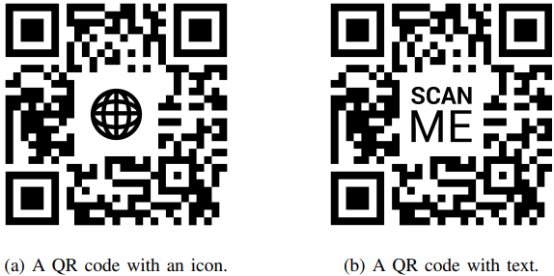
QR Code Phishing Detection Technique
Presented by :Chetan Sharma
Roll No : PTS2201
M.Tech (By Research ) @CAIR IIT-MANDI
Guide : Dr. Amit Shukla
Assistant Professor ,
Chairperson ,CAIR@IIT Mandi

Slide 2
Outline
1.Introduction
2.QR code Phishing Attacks
3.Literature survey
4.Research Gaps
5.Problem Statement & Challenges
6.Research objectives
7.Research Methodology
8. Conclusion
9. References

Slide 3
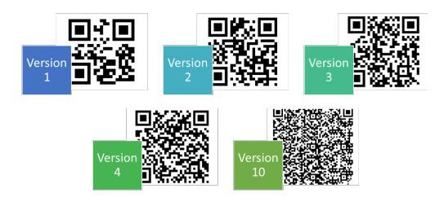
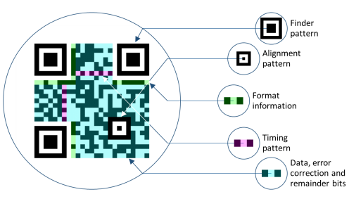
Introduction to QR Code Phishing Detection
What are QR Codes?
Two-dimensional barcodes used for storing information.
Scanned using smartphones to access websites, apps, or digital content.
Security Challenges:
Easy to create and distribute malicious QR codes.
Phishing attacks via QR codes (“QRishing”) trick users into visiting fake websites or sharing sensitive data.

Slide 4
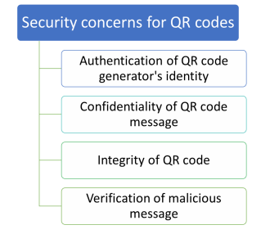
Security Challenges in QR Codes
Challenges:
- Vulnerable to manipulation, replacement, and hidden malicious content.
- Limited human readability makes them susceptible to attacks.
- Lack of built-in authentication mechanisms.

Slide 5
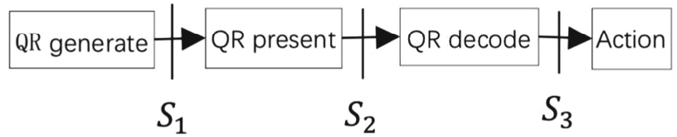
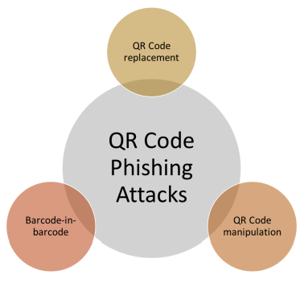
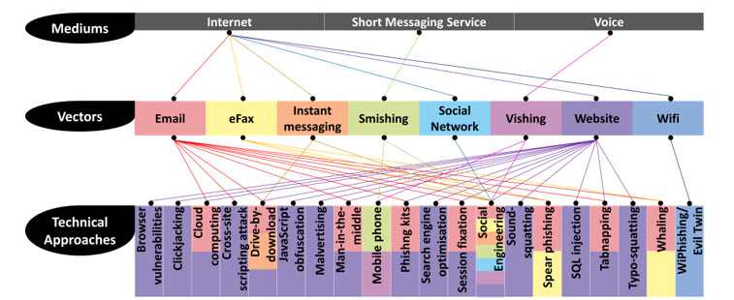
Types of QR Phishing Attacks
QR Code Replacement:
Legitimate QR codes replaced with malicious ones.
Example: Redirecting “ebay.com” to “gbay.com”.
QR Code Manipulation:
Obfuscated URLs or shortened links.
Mobile OS often hides full URLs, increasing risks.
Barcode-in-Barcode Attacks:
Exploits error correction to hide
malicious content inside a
legitimate QR code.

Slide 6
Literature Review Highlights
S. Ismail et al. (2021):
Framework to authenticate QR codes and detect phishing.
Focused on detecting malicious URLs embedded in QR codes.
A. S. Rafsanjani et al. (2023):
QsecR: Privacy-friendly QR scanner achieving 93.5% accuracy.
B. Herlina et al. (2023):
Used XGBoost for phishing detection, achieving 92% accuracy.
M. Thakare et al. (2023):
Machine learning and CNN-based secure QR code scanner.

Slide 7
Research Gaps Identified
Following are the various research gaps: -
1. The schemes which are already proposed for the phishing detection are unable to establish relation between attribute set and target set due to which optimal level of accuracy is not achieved.
2. The models for the phishing detection are based on the machine learning techniques. The machine learning models are supervised model. In the previous research no, one proposed unsupervised model for the phishing detection.
3. The models which are already proposed are unable to work on the QR codes for the phishing detection. The model needs to propose which can detect phishing from QR codes.
Existing models don’t target QR codes for phishing detection.
Heavy reliance on supervised learning; unsupervised methods are underexplored.
Inadequate accuracy due to weak feature-target relationships.

Slide 8
Problem Statement
Phishing via QR codes leverages deceptive tactics to extract sensitive user information.
Existing detection methods lack adaptability and precision in tackling evolving threats.

Slide 9
Challenges in QR Phishing Detection
1. Identifying obfuscated URLs or shortened links.
2. Detecting manipulation in legitimate QR codes.
3. Addressing the scalability of detection methods.

Slide 10

Proposed Countermeasures
Display decoded URLs before opening them.
Notify users if multiple barcodes are detected.
Strengthen barcode reader functionality to flag suspicious QR codes.
Implement machine learning to analyze QR code attributes.
Fig. 5. Example of a manipulated QR code

Slide 11
Research Objectives
Study and analyze phishing QR detection techniques.
Implement machine learning methods for QR phishing detection.
Design a robust hybrid approach for improved accuracy.
Compare the proposed approach with existing methods using metrics like accuracy, precision, and recall.

Slide 12
Proposed Methodology
Data Preprocessing:
Remove missing values.
Extract relevant features (e.g., URL structure, domain reputation).
Feature Extraction:
Analyze patterns and anomalies in QR codes.
Classification:
Implement a voting-based classifier combining multiple ML models.

Slide 13
Research Methodology - Part 1
Detailed content for research methodology section 1.
Data preprocessing, feature extraction, and classification are key steps.

Slide 14
Research Methodology - Part 2
Detailed content for research methodology section 2.
Data preprocessing, feature extraction, and classification are key steps.

Slide 15
Research Methodology - Part 3
Detailed content for research methodology section 3.
Data preprocessing, feature extraction, and classification are key steps.

Slide 16
Research Methodology - Part 4

Slide 17
Research Methodology - Part 5

Slide 18
Research Methodology - Part 6

Slide 19
Research Methodology - Part 7

Slide 20
Research Methodology - Part 8

Slide 21
Research Methodology - Part 9

Slide 22
Research Methodology - Part 10

Slide 23
Decision Tree (DT)
Decision Trees classify data based on splitting criteria from features.

Slide 24
Logistic Regression (LR)
Logistic Regression predicts binary outcomes using logistic function.

Slide 25
Random Forest (RF)
Random Forest uses multiple trees for improved accuracy and robustness.

Slide 26
Naive Bayes (NB)
Naive Bayes uses probabilistic methods for classification based on Bayes' theorem.

Slide 27
Gradient Boosting Machine (GBM)
GBM optimizes weak models iteratively for strong predictions.

Slide 28
K-Nearest Neighbors (KNN)
KNN predicts class based on proximity to k nearest points.

Slide 29
Support Vector Classifier (SVC)
SVC separates data using hyperplanes in higher dimensions.

Slide 30
Convolutional Neural Networks (CNN)
CNN extracts features from image data, ideal for QR code analysis.

Slide 31
Mathematical Equations - Overview
Equations for classification and model optimization will be detailed:
- Logistic regression formula.
- Cost function for SVM.
- Entropy and Gini Index for Decision Trees.

Slide 32
Proposed Hybrid Model - Details 1
Overview of hybrid methodology combining CNN, RF, and Autoencoders (Part 1).

Slide 33
Proposed Hybrid Model - Details 2
Overview of hybrid methodology combining CNN, RF, and Autoencoders (Part 2).

Slide 34
Proposed Hybrid Model - Details 3

Slide 35
Proposed Hybrid Model - Details 4

Slide 36
Proposed Hybrid Model - Details 5

Slide 37
Proposed Hybrid Model - Details 6

Slide 38
Proposed Hybrid Model - Details 7

Slide 39
Proposed Hybrid Model - Details 8

Slide 40
Proposed Hybrid Model - Details 9

Slide 41
Proposed Hybrid Model - Details 10

Slide 42
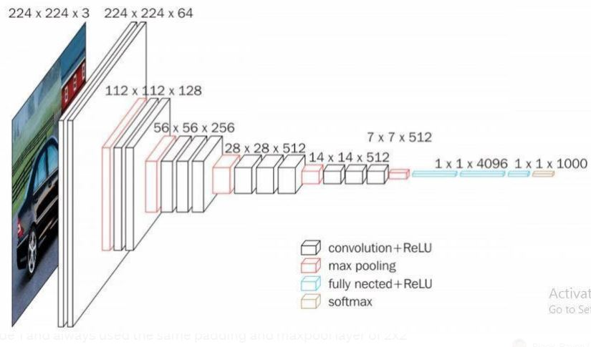
Novel Hybrid Approach
Combines:
CNNs: Extract features from QR code images.
Random Forests: Initial classification.
Auto encoders: Anomaly detection for zero-day phishing attacks.
Hybrid Ensemble Methods: Leverages complementary strengths of models for improved accuracy.

Slide 43
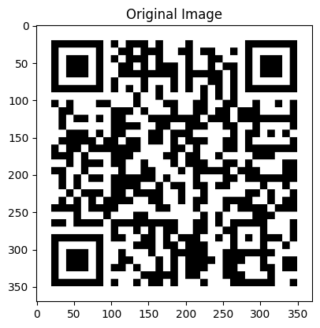
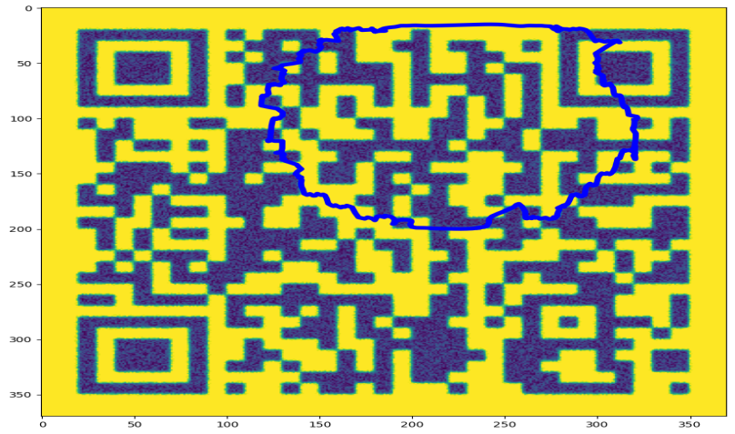
Expected Results
Improved detection accuracy (≥ 91%).
Lower false positive and false negative rates.
Enhanced adaptability to evolving phishing techniques.
Figure : Snake based Segmentation

Slide 44
Results and Evaluation - Slide 1

Slide 45
Results and Evaluation - Slide 2

Slide 46
Results and Evaluation - Slide 3

Slide 47
Results and Evaluation – Slide 4

Slide 48
Results and Evaluation - Slide 5
Results and Evaluation - Slide 1

Slide 49
Results and Evaluation - Slide 6

Slide 50
Results and Evaluation - Slide 7

Slide 51
Results and Evaluation - Slide 8

Slide 52
Results and Evaluation - Slide 9

Slide 53
Results and Evaluation - Slide 10

Slide 54
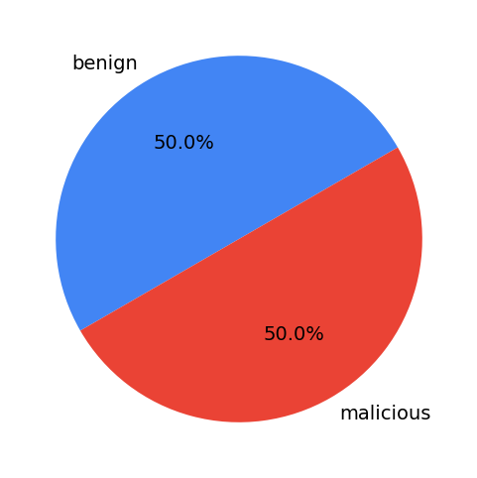
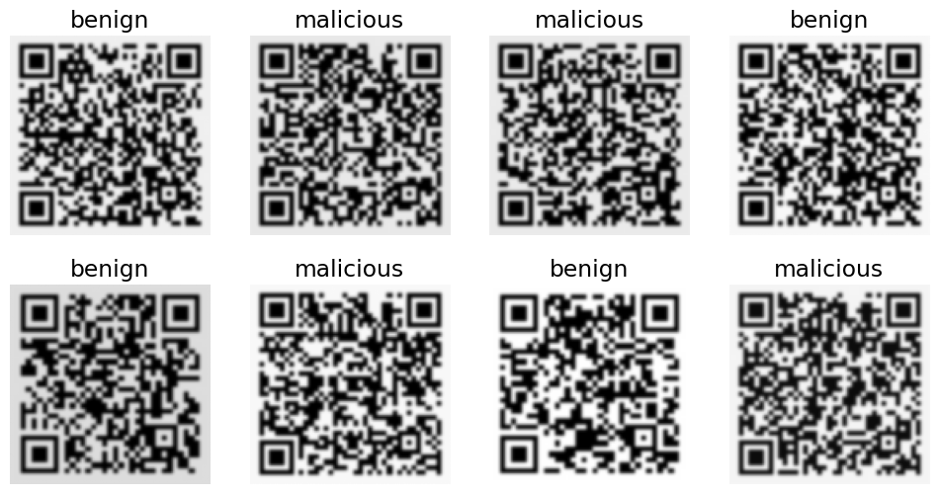
Evaluation Metrics
Accuracy: Measures overall correctness.
Precision: Proportion of correctly identified phishing QR codes.
Recall: Ability to detect all actual phishing QR codes.
F1 Score: Balance between precision and recall. Fig : Class Distribution Fig : Data Set Images

Slide 55
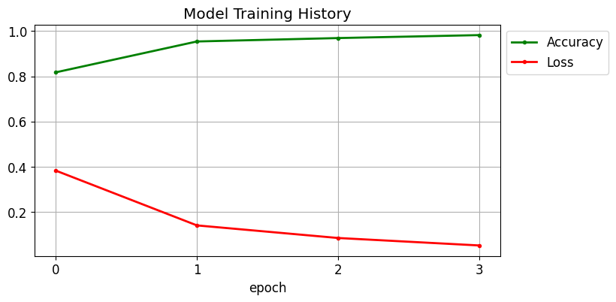
Conclusion
Addresses a critical gap in QR code security by proposing a robust hybrid model.
Combines machine learning techniques to enhance phishing detection accuracy.
Potential applications in:
Payment systems.
Advertisement and marketing.
Access control systems. Figure 16: Training and Model Loss

Slide 56
Conclusion - Summary
1. Combines machine learning techniques for enhanced accuracy.
2. Addresses gaps in QR code phishing detection.
3. Proposes a hybrid model adaptable to evolving threats.

Slide 57
Conclusion - Future Directions
Future Work:
- Explore unsupervised learning techniques.
- Develop lightweight models for mobile applications.
- Extend datasets for improved robustness.

Slide 58
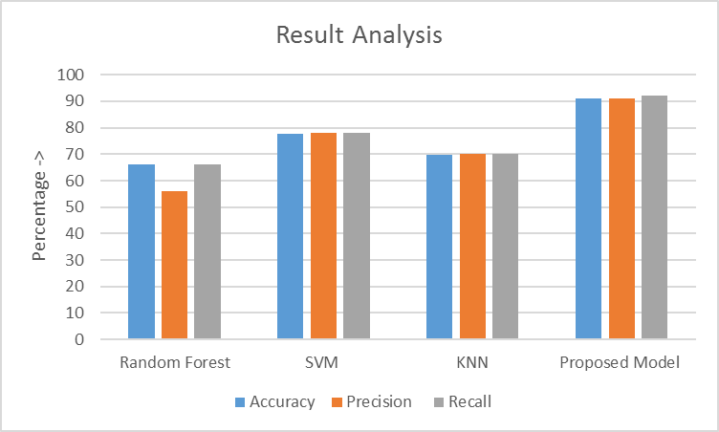
Q&A
Model | Accuracy | Precision | Recall
Random Forest | 66 Percent | 56 Percent | 66 Percent
SVM | 77.59 Percent | 78 Percent | 78 Percent
KNN | 69.88 Percent | 70 Percent | 70 Percent
Proposed Model | 91 Percent | 91.2 Percent | 92 Percent
Table : Result Comparison
Questions?
Thank you for your attention!
Regards : Chetan Sharma
pts2201@students.iitmandi.ac.in

Slide 59
Reference 1

Slide 60
Reference 2

Slide 61
Reference 3

Slide 62
Reference 4

Slide 63
Reference 5

